Slide 1

Design and Implementation of an E-Learning Platform Database System
Saumya Kashyap | DBMS Project

Slide 2
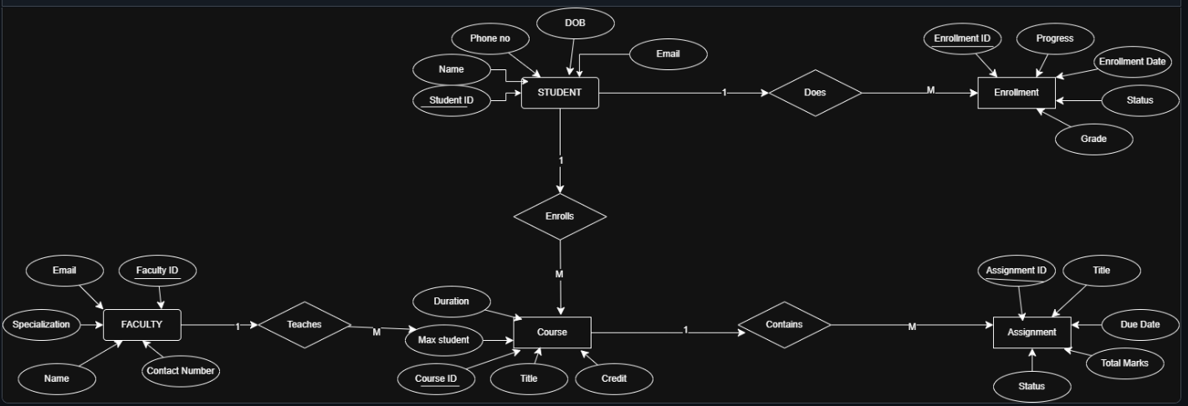
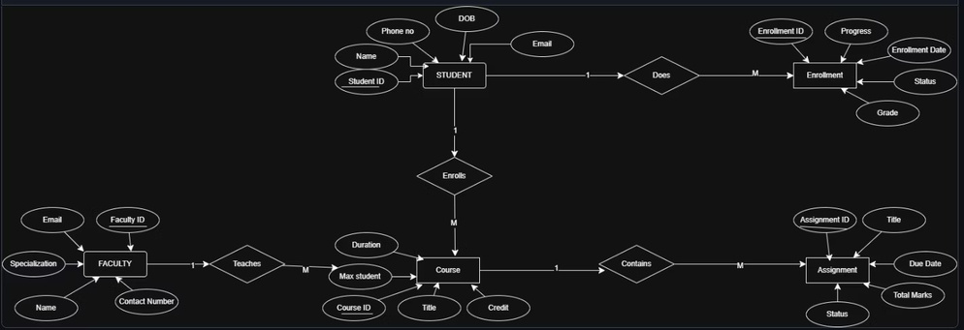
ER DIAGRAM

Slide 3
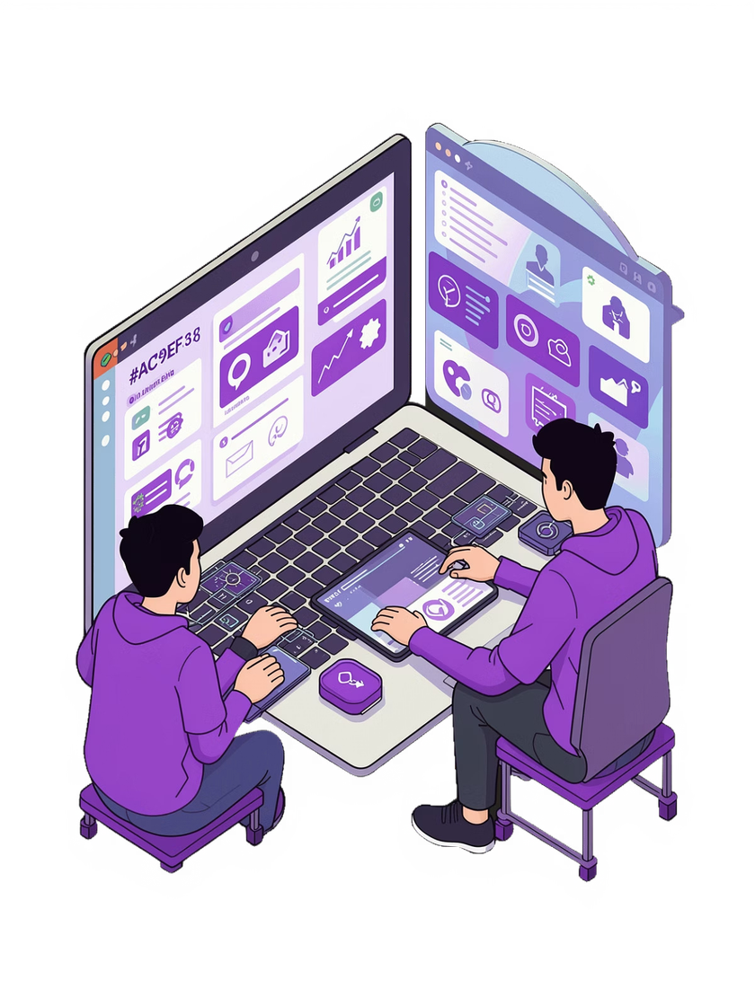
Introduction to E-Learning Database Systems
What is an E-Learning
Database Importance
Platform?
Online learning systemsthat
Database systems serve as the backbone of e-learning
platforms, storing user data,
course materials, grades, and
progress tracking information
securely and efficiently.
deliver educational content, track progress, and manage student-
faculty interactions through a
centralized database
infrastructure.
Real-World Applications: Coursera, Udemy, Khan Academy, and university LMS systems rely on robust database architectures to serve millions of learners.

Slide 4
Project Objectives
Structured Database Design
Create a well-organized schema with logical entity relationships and proper data organization principles
Entity Relationships
Implement and validate relationships between all entities using appropriate cardinality and referential integrity
Normalization to 3NF
Apply normalization techniques to eliminate redundancy and ensure data integrity through 3rd Normal Form
Complex SQL Queries
Develop advanced queries with JOINs, subqueries, aggregations, and conditional logic for data analysis

Slide 5
ER Diagram & Entity Relationships
Student Entity
Manages learner profiles, contact information, and enrollment records
Faculty Entity
Stores instructor details, credentials, and teaching assignments
Course Entity
Contains course metadata, syllabus, duration, and prerequisites
Enrollment Entity
Tracks which students take which courses with enrollment dates
Assignment Entity
Manages homework, projects, quizzes, and assessment details
Status Entity
Records submission status, deadlines, and completion tracking
Grade Entity
Stores scores, letter grades, and performance evaluations

Slide 6
Database Schema Structure
1
Student Table
PK: StudentID | Fields: Name, Email, Phone, Major
2
Faculty Table
PK: FacultyID | Fields: Name, Department, Email, Office
3
Course Table
PK: CourseID | Fields: Title, Credits, FacultyID (FK)
4
Enrollment Table
PK: EnrollmentID | FK: StudentID, CourseID | Fields: EnrollmentDate
5
Assignment Table
PK: AssignmentID | FK: CourseID | Fields: Title, DueDate, MaxPoints
6
Status Table
PK: StatusID | FK: StudentID, AssignmentID | Fields: Submitted, SubmissionDate
7
Grade Table
PK: GradeID | FK: StudentID, AssignmentID | Fields: Score, LetterGrade

Slide 7
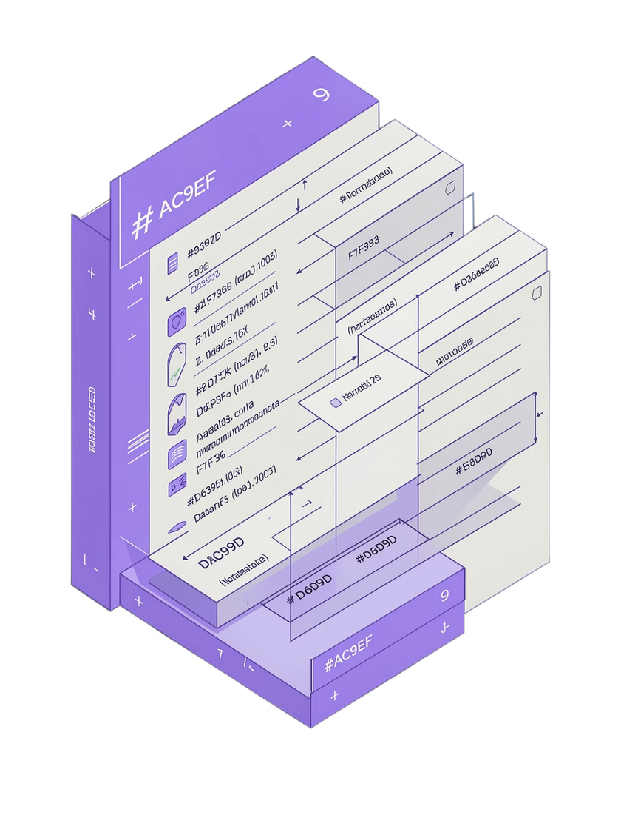
Normalization Process
First Normal Form (1NF)
Eliminate repeatinggroupsby ensuring atomic values in each
column. Create separate tables for assignments, status, and grades instead of storing them as arrays in student records.
Second Normal Form (2NF)
Remove partialdependencies by ensuring all non-key
attributes depend on the entire primary key. This separates enrollment details from student information and course details from faculty information.
Third Normal Form (3NF)
Eliminate transitive dependencies where non-key attributes depend on other non-key attributes. This requires separate status and grade tables to prevent redundant data storage and update anomalies.

Slide 8
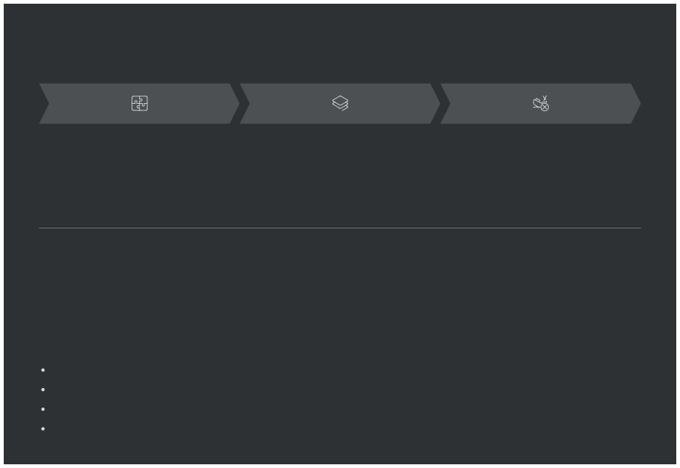
Challenges, Conclusion & Future Scope
Relationship Complexity
Managing M:N relationships required junction tables and careful foreign key placement
Normalization Depth
3NF implementation demanded multiple table splits and complex constraint management
SQL Debugging
Safe update mode restrictions and JOIN syntax errors required iterative testing
Project Success
The database system was successfully designed and implemented with efficient, scalable architecture following normalization principles. The schema supports complex queries and maintains data integrity through proper constraints.
Future Enhancements
Implement secure user authentication and login system with encrypted credentials Develop web or mobile frontend interface for user interaction
Add real-time progress tracking and dashboard analytics
Integrate notification system for assignment deadlines and grade updates

